Slide 1
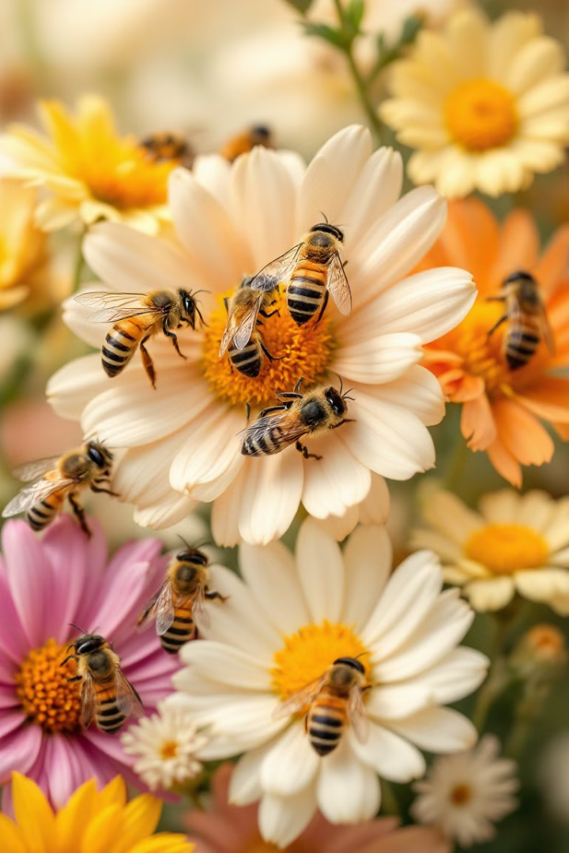
Bee Colony Stressors: Analyzing Impacts on Honeybee Populations
This study examines the "Bee Colony Stressors" dataset, which provides insights into honeybee colonies in the U.S. from 2015 to 2021. The data covers colony losses, additions, and stressors like Varroa mites, pesticides, diseases, and habitat loss—key factors driving global bee population declines. By analyzing patterns across time and states, the research aims to determine whether specific stressors significantly impact bee colonies or if multiple factors contribute to colony losses.
By Digvijay Jhondale & Hashibul Hussain

Slide 2

Dataset Overview and Key Statistics
The "Bee Colony Stressors" dataset consists of two main parts: the colony dataset logging colony losses by state, and the stressor dataset outlining different stressors impacting colonies. Key variables include Colonies Lost, Colony Loss Percentage, and Stress Percentage. Summary statistics reveal a right-skewed distribution for Colonies Lost, with a mean of 8,211 and median of 2,100. The Colony Loss Percentage averages 11.28%, while the Stress Percentage averages 10.41%, with some states experiencing extreme stress levels up to 102%.
Data Collection
1
USDA gathers data on bee colonies and stressors from 2015-2021
2
Data Processing
Researchers compile and clean dataset for analysis
Statistical Analysis
3
Summary statistics calculated to reveal key insights

Slide 3
Trends in Colony Losses and Stressor Impacts
Analysis of colony losses over time reveals fluctuations with distinguishable peaks and troughs. Varroa mites and other pests/parasites emerge as the most significant stressors, aligning with existing literature. California shows the highest losses, while states like Connecticut and Vermont exhibit lower losses. A weak positive correlation (0.18) between colony loss and stress percentage suggests that higher stress is associated with increased losses, but the relationship is limited.
Top Stressors
State Variations
Correlation
Varroa mites and other pests/parasites have highest impact
California experiences highest losses, Connecticut and Vermont lowest
Weak positive correlation (0.18) between stress and colony loss

Slide 4
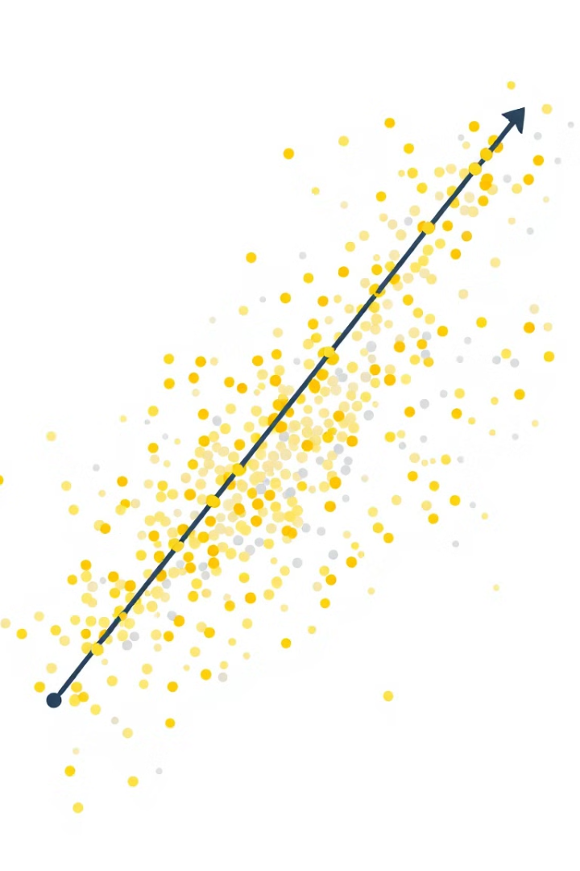
Statistical Analysis and Regression Model
A regression model examining the relationship between colony loss and stress percentage reveals a wide range of prediction errors. The residual standard error is 3685.72, with a multiple R-squared of 0.9879 and adjusted R-squared of 0.9754. A pairs plot shows a positive trend between stress percent and colony loss, but the correlation appears weak. The spread in the data and presence of outliers suggest that other factors may also be influencing colony loss.
Residual Range
R-squared
-13736.9965 to 13736.9965
0.9879 (Multiple), 0.9754 (Adjusted)
Correlation
Other Factors
Weak positive trend between stress and loss
Data spread suggests additional influences

Slide 5
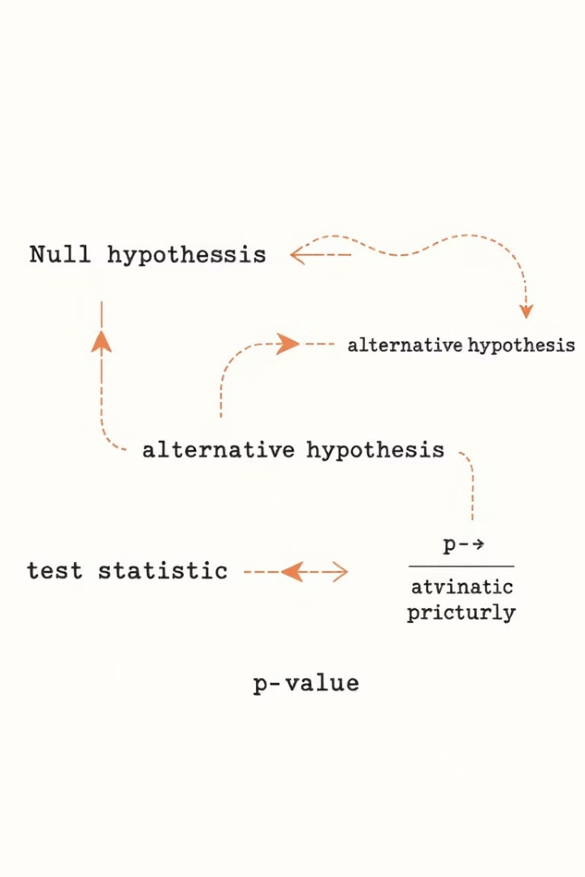
Hypothesis Testing Results
Two hypothesis tests were conducted. The first, a proportions test for colony losses between high and low stress states, yielded a p-value of 0.8062, indicating no significant difference. The second test examined the relationship between different stressors and colonies lost. Shapiro-Wilk normality tests showed most stressors departing from normality, justifying the use of a Kruskal-Wallis test. This non-parametric test resulted in a p-value of 0.7067, suggesting no significant evidence that colony loss differs between stressor categories.
Test
Statistic
P-value
Proportions Test
0.060185
0.8062
Kruskal-Wallis
2.9562
0.7067

Slide 6

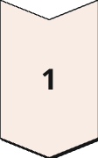
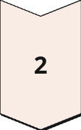
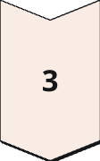
Conclusions and Implications
The analysis reveals that factors influencing bee colony losses are complex. While some stressors, like Varroa mites, appear significant, their individual impact on colony losses is weak. Statistical tests provide insufficient evidence to support claims that stressors individually have a significant effect on colony loss. However, these stressors combined with other factors might amplify the effect. The study's limitations include focusing on individual stressors' impact, suggesting future research should consider the cumulative effects of multiple stressors and additional environmental factors on bee colony health.
Complex Factors
Multiple influences on colony losses
Weak Individual Impact
Stressors alone show limited effect
Future Research
Consider cumulative effects and additional factors

